Slide 1
UHR/PAYROLL FORUM
January 12, 2024

Slide 2


General Forum Information
You can raise your hand or put your questions in the chat
The forum is recorded
You can find the recording and slides for the monthly meetings the UHR Calendar and Communications website: https://hr.oregonstate.edu/calendar-and-communications (links and topics for future forums are also listed there)

Slide 3
Agenda
Announcements
New year training offerings for employees and supervisors
ACA and 1095C update/timeline
W-2/W-4 update/timeline
Meet the Benefits team
Updated Benefits Summaries

Slide 4

Announcements
Lyra Health is now available to employees and their dependents (not tied to PEBB eligibility)
Instructor Pool guidance is now available on our Recruitment and Selection Resources webpage
We have a new "Remote or Hybrid option" field for our postings and an associated search option on the jobs page
PERS on-campus presentations on February 27 in MU 104
  9:00-11:00: All About OPSRP (for OPSRP members only)
  1:00-3:00: Retirement Readiness (for Tier members within three years of retirement)

Slide 5
More Announcements!
OSU Employee Appreciation Night on Sunday 4/21/24 at Patricia Valian Reser Center for the Creative Arts (PRAx) hosted by the Office of University Human Resources. This event is for all OSU employees and their families! Tickets for employees are at reduced price of $5 with no ticket limit.
  Family-friendly/employee appreciation activities including a scavenger hunt, a photobooth, and complimentary beverages and desserts will be in a designated OSU employees-only reception room between 6-7pm
  The Derina Harvey Band, a Canadian Celtic rock sensation, will perform at 7pm
Say Hey! event hosted at OSU on February 27 by the Portland Partners in Diversity
  Multi-cultural networking event to help connect local businesses and community members with professionals of color who recently relocated to Oregon or southwest Washington. The goal is to build community, deepen connections, and create an environment where everyone is welcomed
  Employees of Color are honored at the event and encouraged to register as honorees; community members and allies are encouraged to attend also to support building community and connections
  Register now!
    Attendees: https://www.partnersindiversity.org/event/say-hey-february-2024/
    Honorees: https://www.partnersindiversity.org/program/honorees/#honoreeform

Slide 6
Search Advocate Program
Become a Search Advocate!
Continuing education events
Social Justice Education Initiative
Monthly Tier One Workshops
Periodic Next Level Workshops
Learning & Development
New year training offerings for employees and supervisors
Click the name of the program to learn more!
FourSight Mindset Reveal
2-hour workshop
Quarterly via Zoom
& in-person options
$55 fee
New Employee Orientation
First Wednesday of every month via Zoom
Core Curriculum for Managers & Supervisors
Series of four half-day workshops
Quarterly via Zoom
Crucial Conversations for Mastering Dialogue
Series of five 2-hour workshops
Quarterly via Zoom & in-person options
$100 fee
LinkedIn Learning
Over 18,000 self-paced courses
FREE to OSU faculty, staff, and students!
FYI Fridays
Weekly via Zoom
Fall-Spring Term
Find even more learning opportunities in
the Training Portal!
Via my.oregonstate.edu
OSU Critical Training Program
Self-paced online via Bridge
UHR Learning & Development
On the web: https://hr.oregonstate.edu/training
Email: hr.training@oregonstate.edu

Slide 7

ACA and 1095C update/timeline
The employer deadline to mail the 1095C form to employees is 03.01.2024
The 1095C is a reference document and generally isn't required in order to file individual tax returns. Consult a tax professional for details related to the 1095C and other tax questions
IRS FAQ – under Health Care Coverage Documents: Questions and Answers about Health Care Information Forms for Individuals | Internal Revenue Service (irs.gov)
OSU received the spreadsheet of PEBB enrollees on 01.03.2024 and will be reviewing and updating the data. The OSU deadline to return the spreadsheet to PEBB is 01.23.2024
PEBB will be loading the data and testing it with their third party 1095C administrator before mailing the 1095C forms
OSU Employees enrolled in the Pacific Source plan will be included on the spreadsheet we provide to PEBB. PEBB's third party 1095C administrator will also complete the 1095C for this group even though they are not PEBB members. Note: Only those enrolled individuals with qualifying FTE/Hours will receive a 1095C
Employees who don't receive the 1095C by 03.01.2024 can reach out to PEBB to request a copy. Phone 1.503.373.1102 or email pebb.benefits@odhsoha.oregon.gov

Slide 8

W-2 Time!
Employer deadline for mailing W-2 forms to employees is 01.31.2024 (but I anticipate sometime the week of Jan 22-27)
To Current Mailing address as of 8am 01.08.2024
1042-S Non-Resident Alien (NRA) tax exempt income form. Mailing deadline is 3.15.2024 but usually out early Feb.
Files already submitted to USSE but there are additional processes before forms printed & mailed.
W-2's will be available in MyOregonstate on 02.01.2024.
Employees who have not received their W-2 by 02.01.2024 can generate a duplicate at https://my.oregonstate.edu/employee
For NRA's - W-2's & 1042's are NOT available on-line, hard copy only.
NRA's will need to direct duplicate requests to PayrollServices@oregonstate.edu or submit a Duplicate Tax Form request via the Employee Service Portal (https://mysupport.oregonstate.edu/esp)
Note: If name address or name is no longer accurate, we do not generate corrected forms. Simply draw a line through the item and above it write in the correct address or name.

Slide 9

W-4 Status
Please use new 2024 W-4's and OR-4's going forward. All new hire forms have been updated.
After Jan 22, 2024 we will not accept 2023 forms.
Exempt filers expire annually Feb. 15. Must refile new Exempt W-4 (and/or OR-4) if they want to continue the exemption.
We do not refund withheld taxes if employee missed refiling exempt status. Only goes forward from time of filing.
Any Questions?

Slide 10

Meet the Benefits team
Bonny Ray – Executive Director of the Office of University Human Resources
Rachel Forslund – Employee Benefits Manager, PEBB and Grad Health
Christina Schaaf – Work Life Coordinator
Denis Ellrodt – HR Graduate Health Benefits Specialist
Jessica Dalziel – HR Benefits Systems Analyst, ACA, Reconciliations, Staff Fee
Audrey Roberson – HR Retirement Officer, Savings, Education, Programs
Ruth Nelson – HR Retirement Officer, Savings, Education, Programs
Betty Buck – HR PEBB Benefits Specialist, Terminations & Medicare
Brittney Holcomb – HR PEBB Benefits Specialist, Current Employees and Life Events
Harrison Edwards – HR PEBB Benefits Specialist, New Hires
Elizabeth Moreno-Hernandez – HR Benefits Specialist, Grad Health and Retirement
PEBB Benefit Questions? Employee.pebbbenefits@oregonstate.edu
Retirement Questions? Retirement@oregonstate.edu
Graduate Insurance Questions? Gradhealth@oregonstate.edu

Slide 11

Updated Benefits Summaries
The 2024 Benefit Summaries for Classified Employees, and Professional and Academic Faculty are now updated on the HR Website:
https://hr.oregonstate.edu/benefits/current-employees/insurance/summary-benefits
You can find information on:
Core Coverage (Medical, Dental, Vision, Basic Life)
Disability Coverage
Life Insurance
Flexible Spending Accounts
Retirement Options
Staff Fee
Other campus benefits and discounts

Slide 12

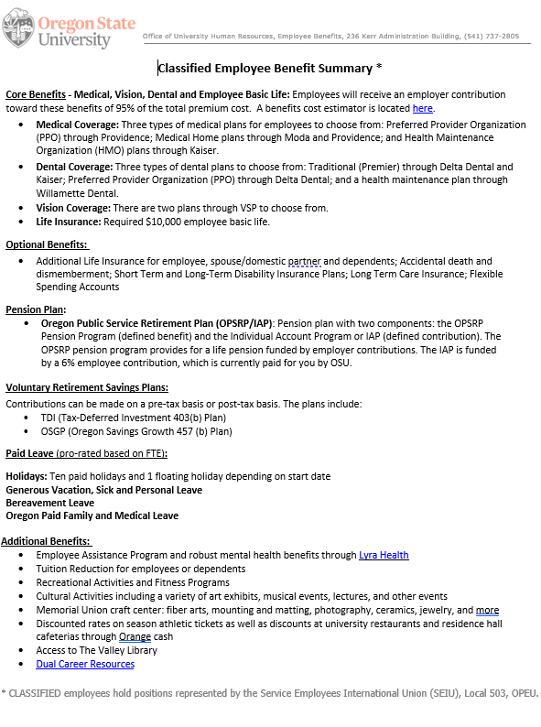
One Page Benefit Summary
Our website is currently being updated to add the one-page document.
If document is needed for candidates and recruitment, please email me at rachel.forslund@oregonstate.edu

Slide 13

Questions?

Slide 14
THANK YOU

