Slide 1
UHR/PAYROLL FORUM
January 2026

Slide 2




General Information
You can raise your hand or put your questions in the chat
Forums are always recorded
You can find recordings and slides for each forum on the UHR Calendar and Communications website: https://hr.oregonstate.edu/calendar-and-communications (links and topics for future sessions are also listed there)
This forum’s recording and slides will be emailed along with the registration link and list of topics for the next forum

Slide 3
Agenda
Announcements
Timely notifications for terminations
Beavs Mobile phone plans
Updated benefits summaries
ACA and 1095C update/timeline
W-2/W-4 update/timeline

Slide 4
Announcements
Reminder: PEBB’s Open Enrollment correction period November 1 – February 28 and is available only for those who completed Open Enrollment in October.
Visit https://www.oregon.gov/oha/PEBB/FORMS/Open-Enrollment.pdf for a paper form.
Please return to the PEBB Benefits Team at 236 Kerr Administration Building, OR via email at Employee.pebbbenefits@oregonstate.edu
Reminder – background check vendor change: Our current background check vendor, Sterling, has been acquired by First Advantage. The vendor’s name will change, but the background check process remains the same. Candidates will receive their invitation email from First Advantage (sender: noreply@us.fadv.com) to complete the process. During the transition, you may still see some references to Sterling until the process is fully completed. Support communications will also come from First Advantage.

Slide 5
More announcements!
Reminder: Oregon Paid Family and Medical Leave (OPFML) update
Administration of Oregon Paid Family Medical Leave (OPFML) has transitioned internally beginning January 1, 2026. UHR’s Protected Leaves team will be process and administer all OPFML cases. OPFML requests that have been processed prior to December 31, 2025 will continue to be administered directly by The Standard until the leave has concluded. This change will bring several benefits:
Improved service delivery
A single point of contact from the UHR Protected Leave Team from the start of a leave through to the completion of the leave;
OPFML pay will be delivered directly to employees via OSU’s pay system; and
Process alignment and improved, coordinated communication for employees and their supervisors through UHR’s Protected Leaves team.
Reach out to medical.leave@oregonstate.edu for questions

Slide 6

Timely notifications for terminations
If you or a member of your team is leaving OSU, whether for a new role or exiting the university, notify your supervisor and University Human Resources immediately.
If you or a member of your team is leaving OSU, please be aware that final pay will be issued on your last day if given timely notice. If notice of termination is received late, this can impact when the employee receives their final pay.
For Student Hourly or Graduate Assistant positions, email student.employment@oregonstate.edu
For all other positions, email hrsupportservices@oregonstate.edu
Final Pay
Final Pay is mailed out to the employee's current mailing address on file.
Prior to their last day employee's need to review current mailing address to ensure it is correct and up to date.
For questions regarding your final pay email payrollservices@oregonstate.edu

Slide 7


Introducing Beavs Mobile
What is Beavs Mobile?
Beavs Mobile recently partnered with OSU to provide affordable wireless plans for OSU employees, students, and fans.
Through this partnership, Beavs Mobile gives back up to 7% to OSU every time a customer pays their bill. New customers can choose to have their contribution support either the OSU Athletic Fund or the OSU Scholarship Fund.
Beavs Mobile offers seamless coverage on the T-Mobile 5G Network
OSU Employees and their families receive a 20% discount – Click HERE to learn more
If you have questions, contact Aaron Babcock at aaron.babcock@oregonstate.edu

Slide 8
Why choose Beavs Mobile?
OSU Employee plans start at $16 a month – Affordable, transparent pricing with no hidden fees.
Built for Beaver Nation – Beavs Mobile contributes to OSU every time you pay your bill, turning your wireless service into lasting impact for OSU.
No contracts, no commitments – Bring your phone and keep your number with freedom to switch anytime.
Exclusive Game Day perks – VIP experiences, free tickets on game days, and premium giveaways for Beavs Mobile customers.
On the T-Mobile 5G Network – Seamless coverage with coast-to-coast 5G.

Slide 9

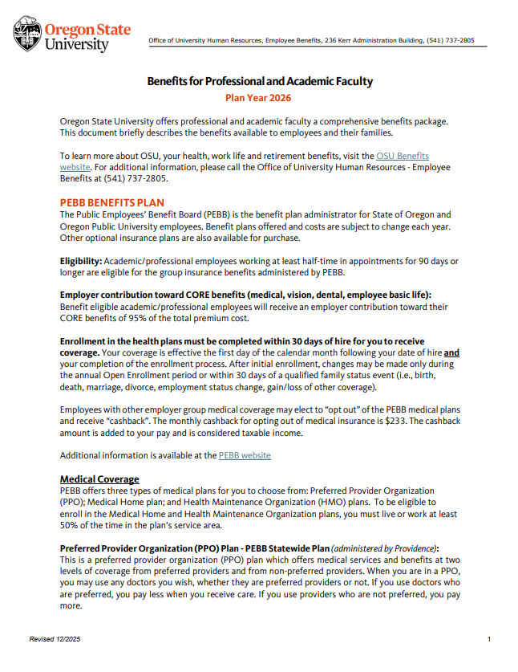
Updated 2026 benefit summaries
The 2026 benefit summaries for Classified Employees and Professional & Academic Faculty are now updated on the UHR Website: Benefits Summaries for 2026
You can find information on:
Core coverage (Medical, Dental, Vision, Basic Life)
Disability coverage
Life insurance
Flexible Spending Accounts
Leave accrual and use
Retirement options
Staff Fee
Other campus benefits and discounts

Slide 10

ACA and 1095C update/timeline
The employer deadline to mail the 1095C form to employees is March 2, 2026
Generally, the 1095C isn't required to file individual tax returns. Consult a tax professional for details related to the 1095C and other tax questions
IRS FAQ – under Health Care Coverage Documents: Gathering Your Health Coverage Documentation for the Tax Filing Season | Internal Revenue Service (irs.gov)
OSU received the spreadsheet of PEBB enrollees on December 22, 2025 and will be reviewing and updating the data. The OSU deadline to return the spreadsheet to PEBB is January 16, 2026
PEBB will be loading the data and testing it with their third party 1095C administrator, Thomas Reuter, through January 31, 2026
OSU PostDoc employees that were enrolled in the PacificSource plan will be included on the spreadsheet we provide to PEBB. Thomas Reuter will also complete the 1095C for this group even though they are not PEBB members. Eligible Cigna enrollees will receive a 1095C from Cigna directly.
Eligible OSU Federal Employees will also receive a 1095C from Thomas Reuter
Employees who don't receive the 1095C by March 15, 2026 can contact PEBB at: pebb.benefits@odhsoha.oregon.gov

Slide 11

W-2/W-4 update/timeline
W-2's - mailed to Home (CM) address by 1/31/26 (if your address is updated after 1/7/2026 please ensure forwarding is set up)
Online W-2's will be available 2/2/26
W-4's – 2026 W-4’s available soon. W-4 link will be updated with the new form.
After 1/31, the 2025 version will not be accepted
OR-4 - 2026 version is out and in MyOregonState; you may also access/download it here: DOR 2026 OR-W-4
Exempt filers - W-4 expires 2/15/26
Must refile new 2026 W-4 to keep Exempt status for February 2026, otherwise it will default to Single

Slide 12

Questions?

Slide 13
THANK YOU

