Slide 1

UHR/PAYROLL FORUM
February 13, 2026

Slide 2




General Information
You can raise your hand or put your questions in the chat
Forums are always recorded
You can find recordings and slides for each forum on the UHR Calendar and Communications website: https://hr.oregonstate.edu/calendar-and-communications (links and topics for future sessions are also listed there)
This forum’s recording and slides will be emailed along with the registration link and list of topics for the next forum

Slide 3
Agenda
Announcements
Administrative Modernization Program (AMP) updates
Open Enrollment corrections information

Slide 4
Announcements
Upcoming Lyra Gathering: Running on Empty: Workplace Burnout (private Gathering)
Thursday, February 26th, from 10:00 AM-11:00 AM
Register here
Information about Lyra Gatherings
We do not anticipate a change in how Summer Academic Wage appointments are requested for this year. More information will be presented at the March HR/PR Forum. If you have any questions in advance please reach out to Angela Williamson, angela.williamson@oregonstate.edu

Slide 5
More announcements!
Reminder: Oregon Paid Family and Medical Leave (OPFML) update
Administration of Oregon Paid Family Medical Leave (OPFML) has transitioned internally beginning January 1, 2026. UHR’s Protected Leaves team will be process and administer all OPFML cases. OPFML requests that have been processed prior to December 31, 2025 will continue to be administered directly by The Standard until the leave has concluded. This change will bring several benefits:
Improved service delivery
A single point of contact from the UHR Protected Leave Team from the start of a leave through to the completion of the leave;
OPFML pay will be delivered directly to employees via OSU’s pay system; and
Process alignment and improved, coordinated communication for employees and their supervisors through UHR’s Protected Leaves team.
Reach out to medical.leave@oregonstate.edu for questions

Slide 6




AMP Update
Everything you need to know to stay up to date about AMP
February 2026

Slide 7
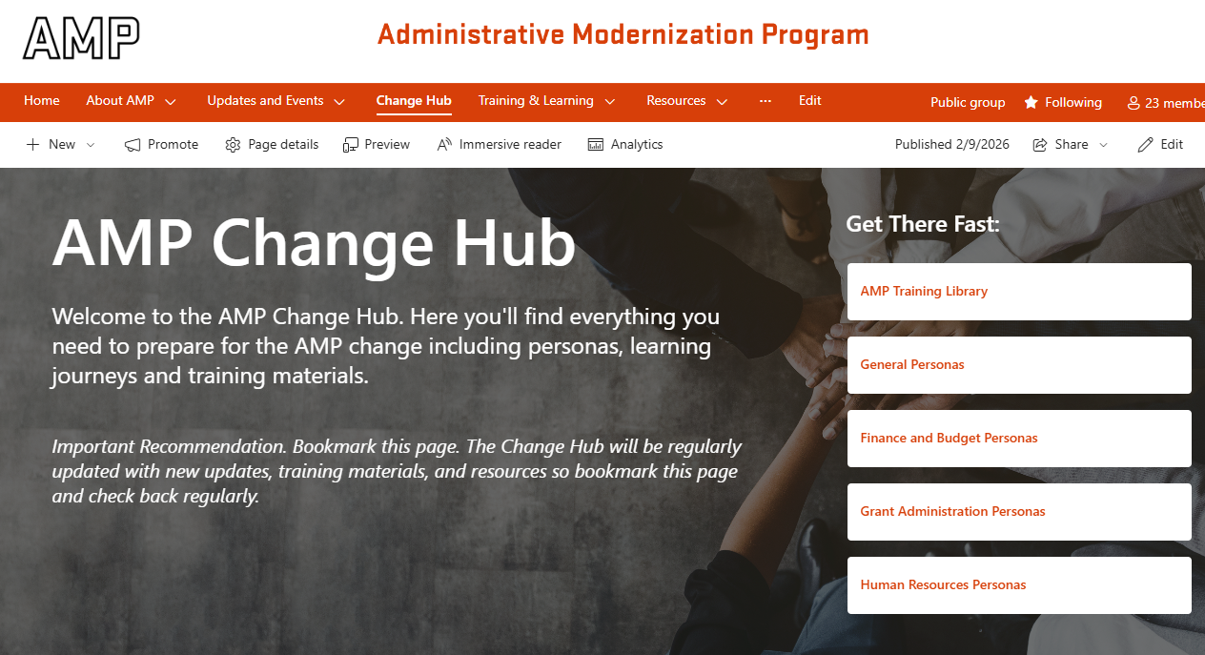
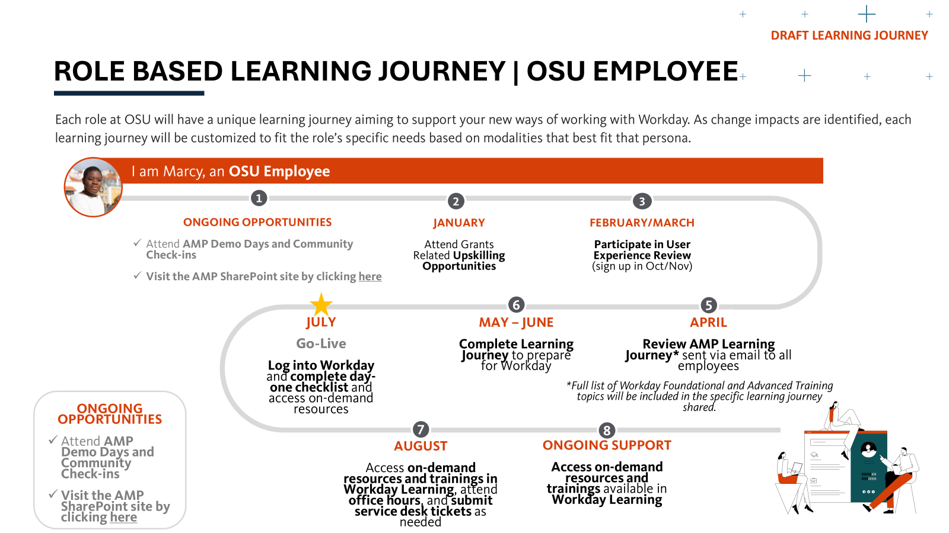
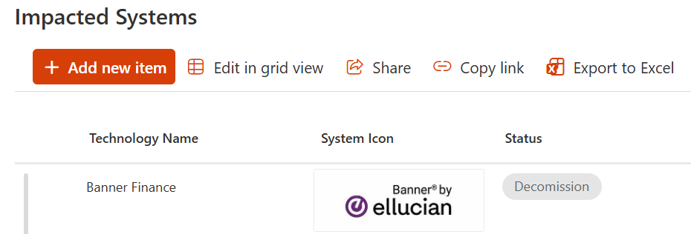

A Closer Look at Key February Updates
AMP’s Change Hub
AMP’s Impact on Current Technology
AMP Training
The Change Hub is a central resource for how AMP impacts the OSU community and training resources. This page will be updated regularly. Here are the upcoming training updates you can expect to see posted:
March: Each persona gets a tailored Learning Journey with required/recommended training.
April: Training materials will be uploaded to the Change Hub.
As we transition to Workday, AMP will affect some of the systems you use today. The AMP team has compiled the expected impacts to current OSU systems and published them on a new SharePoint page.
Here’s how to interpret the different impact types:
Decommissioned: You’ll stop using the system—it will be retired.
Unimpacted: No change—you’ll keep using the system as you do today.
Integrates with Workday: The system will remain, but how you use it may change, and its data will flow into Workday.
To be determined: AMP is still evaluating what will happen to the system.
We’ve heard across the community that one of the biggest questions (and a bit of understandable concern) is how you’ll be trained. Here’s a quick overview of the training timeline and how you can expect to be prepared.
Jan/February: Foundational Liaisons are onboarded
March: Learning Journeys are finalized and available to the community.
April: Advanced Trainings preparation
May- June: The community will complete trainings and prepare for Go-Live
July: Go-Live support from AMP team, foundational liaisons, and Change Champions
Why it matters to me:
Understand the impact: In the Change Hub, select your persona to understand how AMP will impact you.
Why it matters to me:
Cutover – Preview for next month: In the coming weeks, we’ll share what teams need to do to prepare for Go-Live as systems are decommissioned or integrated with Workday. This preparation process is called cutover.
Why it matters to me:
Go-Live Preparation: You’ll have over two months to get started, and you won’t need to be an expert on Day 1—we’ll have strong support in place to help you.

Slide 8

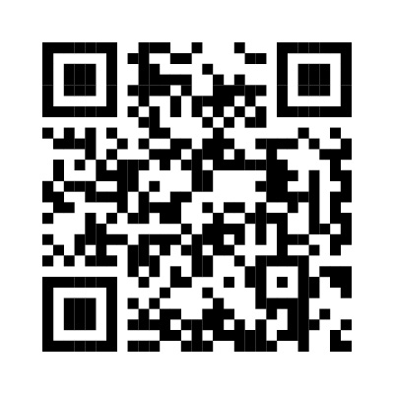

Ask ChAMP about how AMP will impact you!
AMP QUICK LINKS
AMP SharePoint: beav.es/AMP-sharepoint
Find your Change Champion: beav.es/AMP-change-champions
Ask questions and submit feedback via the Always on Survey: beav.es/AMP-always-on-survey
AMP Glossary: beav.es/AMP-glossary
AMP Video Library: beav.es/AMP-video-library
AMPlifier (AMP’s Newsletter): beav.es/AMPlifier

Slide 9

Open Enrollment corrections
The Open Enrollment Correction period is November 1, 2025 – February 28, 2026 for those that completed Open Enrollment for PEBB health insurance
Effective dates of corrections February 1 – February 28, 2026: effective March 1, 2026. Corrections can be made to:
Plan Corrections
Dependent Corrections
Tobacco Surcharge
Other Coverage Surcharge
If you need to make corrections, send an Open Enrollment Correction form to the Employee PEBB Benefits team by February 28, 2026 at 236 Kerr Administration Building or via email at Employee.pebbbenefits@oregonstate.edu
Qualified Status Change (QSC): If you experience a QSC, visit PEBB’s forms page and fill out the Midyear Change Form
Please notify employee.pebbbenefits@oregonstate.edu if you see any discrepancies on your check

Slide 10

Questions?

Slide 11
THANK YOU

