Slide 1

UHR/PAYROLL FORUM
March 13, 2026

Slide 2




General Information
You can raise your hand or put your questions in the chat
Forums are always recorded
You can find recordings and slides for each forum on the UHR Calendar and Communications website. Links and topics for future sessions are also listed there.
This forum’s recording and slides will be emailed along with the registration link and list of topics for the next forum

Slide 3
Agenda
Announcements
UHR/AMP cutover dates
OPE rate increase
Summer Academic Wage (SAW) appointment process
Sneak peek at Fixed-Term Renewals for April Forum

Slide 4
Announcements
OSU faculty and staff can sign up for a free 3-day pass to OSU’s recreation facilities. This offer is for new employees who attend orientation, but it is now being extended to current employees!
  You can also choose an extra perk, such as a Fitness Foundations Class or obtaining a Belay Certification
  If you have any questions, please reach out to Keenyn Santiago, Business Operations and Membership Coordinator in Recreational Sports, at keenyn.santiago@oregonstate.edu
Instructor Pool options as we transition to Workday:
Hiring units may wait to post their 2026/2027 Instructor pools until after Workday goes live July 6th; OR
They may extend their current academic year pools to be able to hire through Fall term in PeopleAdmin and then create new pools, if needed, for Winter/Spring in Workday.
This is a one-time exception, and future years will need to follow the academic year timeline like we do now. Please reach out to HRRecruitment@oregonstate.edu if you have any questions.

Slide 5

Announcement – National Student Employment Week (April 13-17)
Celebration events happening at Corvallis, April 14 (3-5pm) and OSU-Cascades, April 15 (2-4 pm)
"Wall of Fame" student appreciation
Unit level activities
Keep an eye out for email from:
  Dan Larson
  Vice President for Student Affairs
  Bonny Ray
  Executive Director, University Human Resources
  Links to student employee Video and SharePoint site
  with ways to get involved.

Slide 6
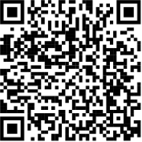
Announcement – Financial Literacy Month
The OSU Employee Benefits Retirement Team invites all OSU Employees to attend financial literacy sessions in April for Financial Literacy Month. Registration is open now!
  Understanding Retirement Options at OSU. Led by OSU Retirement. April 2, 9-10 a.m.
  Build Smart Financial Habits for Success. Led by TIAA. April 8, 1-2 p.m.
  Fundamentals of Retirement Income Planning. Led Fidelity. April 16, 12-1 p.m.
  Introduction to Oregon Savings Growth Plan. Led by OSGP. April 20, 2-3 p.m.
  All about OPSRP. Led by PERS. April 28, 10-12 p.m.
Attend as many sessions as you wish. To register, scan the QR code and search for Financial Literacy.
All sessions will be held on Zoom.

Slide 7

UHR/AMP cutover dates
Dates associated with Position Descriptions (PDs) and Salary Changes:
Now – 3/31/26
4/1/26 – July 2026
Early July 2026 - Onward
Requests for Position Changes (reclassifications, reassignments, etc.) and off-cycle Salary Changes to UHR Classification and Compensation will be actively reviewed
Requests will not be received/reviewed (temporary)
Resume submitting Position Change and off-cycle Salary Change requests under normal operations
It is important to get any requested changes to the Classification & Compensation team prior to April 1, 2026 to make entries prior to the go-live date.

Slide 8
UHR/AMP cutover dates, cont.
Dates associated with Position Descriptions (PDs)
Immediately
Now – 4/1/26
Now – July 2026
Post-Early July 2026
Requests for updates to non-recruited PDs in PeopleAdmin are not permitted
If a PD change may lead to a reclassification, these can be submitted to UHR Classification and Compensation for review.
Limited/general PD changes can be updated locally; no UHR review or system filing required.
Keep/retain PDs at the college or department level

Slide 9
UHR/AMP cutover dates, cont.
Dates associated with NEW Recruiting and Hiring
By 6/12/26
6/13/26 – 7/6/26
Now – 6/21/26
6/22/26
By 6/30/26
7/6/26
Submit recruitment-related PDs needed for PeopleAdmin recruitment
IMPORTANT: Temporary pause on hiring new employees, including students*
Continue new recruitments in PeopleAdmin
No new recruitments in PeopleAdmin including student recruitments in Benny Hire
Download and save copies of all employees’ PDs in your unit**
Can initiate new searches in Workday; expect a two-week pause during the transition period
If a recruitment starts in PeopleAdmin before the temporary pause: It will continue in PeopleAdmin until completed, even if that’s after Workday go-live
*New employee start dates must be 6/12/26 or earlier, or 7/6/26 or later
*Academic hires and Graduate Assistant hires continue as normal
**Student employees do not have PDs

Slide 10

OPE Composite rate increase
Effective 3/1/26 for PEBB enrolled employees:
  PSA OPE increases from $1,658 to $1,725 per month
  TAY OPE increases from $232.81 to $513.29 (for 9-month employees)
This rate will only affect the remaining four months of the fiscal year (FY26)
Starting with Workday in July OPE charges will change to a percentage of an employee's pay as part of the switch to pooled fringe rates

Slide 11

Summer Academic Wage (SAW) appointment process
Summer Academic Wage processing is right around the corner!
Summer Academic Wage processing is for 9-month employees that are being asked to work over the summer months (June 16 – September 15)
HR Support Services is your team for processing Summer Academic Wage
You will not see a change in processing for Summer Academic Wage this year and will continue to submit your spreadsheets to hrsupportservices@oregonstate.edu

Slide 12

SAW Key Information
Departments can start sending completed spreadsheets to HRSupportServices@oregonstate.edu as soon as they are ready to go
Typically, we see spreadsheets starting May 1
Spreadsheets submitted for June payment need to be submitted early to ensure processing in Banner.
Spreadsheets submitted after June will be processed in Workday

Slide 13
Saw Key Information cont.
If you have changes or new appointments to report, please utilize the same spreadsheet/ticket that you submitted your original spreadsheet on utilizing the Corrections Tab at the bottom
Manual checks are mailed to the employee's current mailing address
Utilize the summer session spreadsheet found here: Summer session appointment process

Slide 14
New SAW Hires
Employees who are new to OSU and will have a summer appointment need to go through the Instructor Pool for applying
Once they have applied you will add them to your spreadsheet for Summer Hiring under the "New SAW Hires" tab
Onboarding for new employees in the summer is informal; however, they are still required to complete required HR Paperwork like the I-9 and W-4
If your employee will also have a Fall Appointment they will be hired via Recruitment and will go through the formal onboarding process

Slide 15
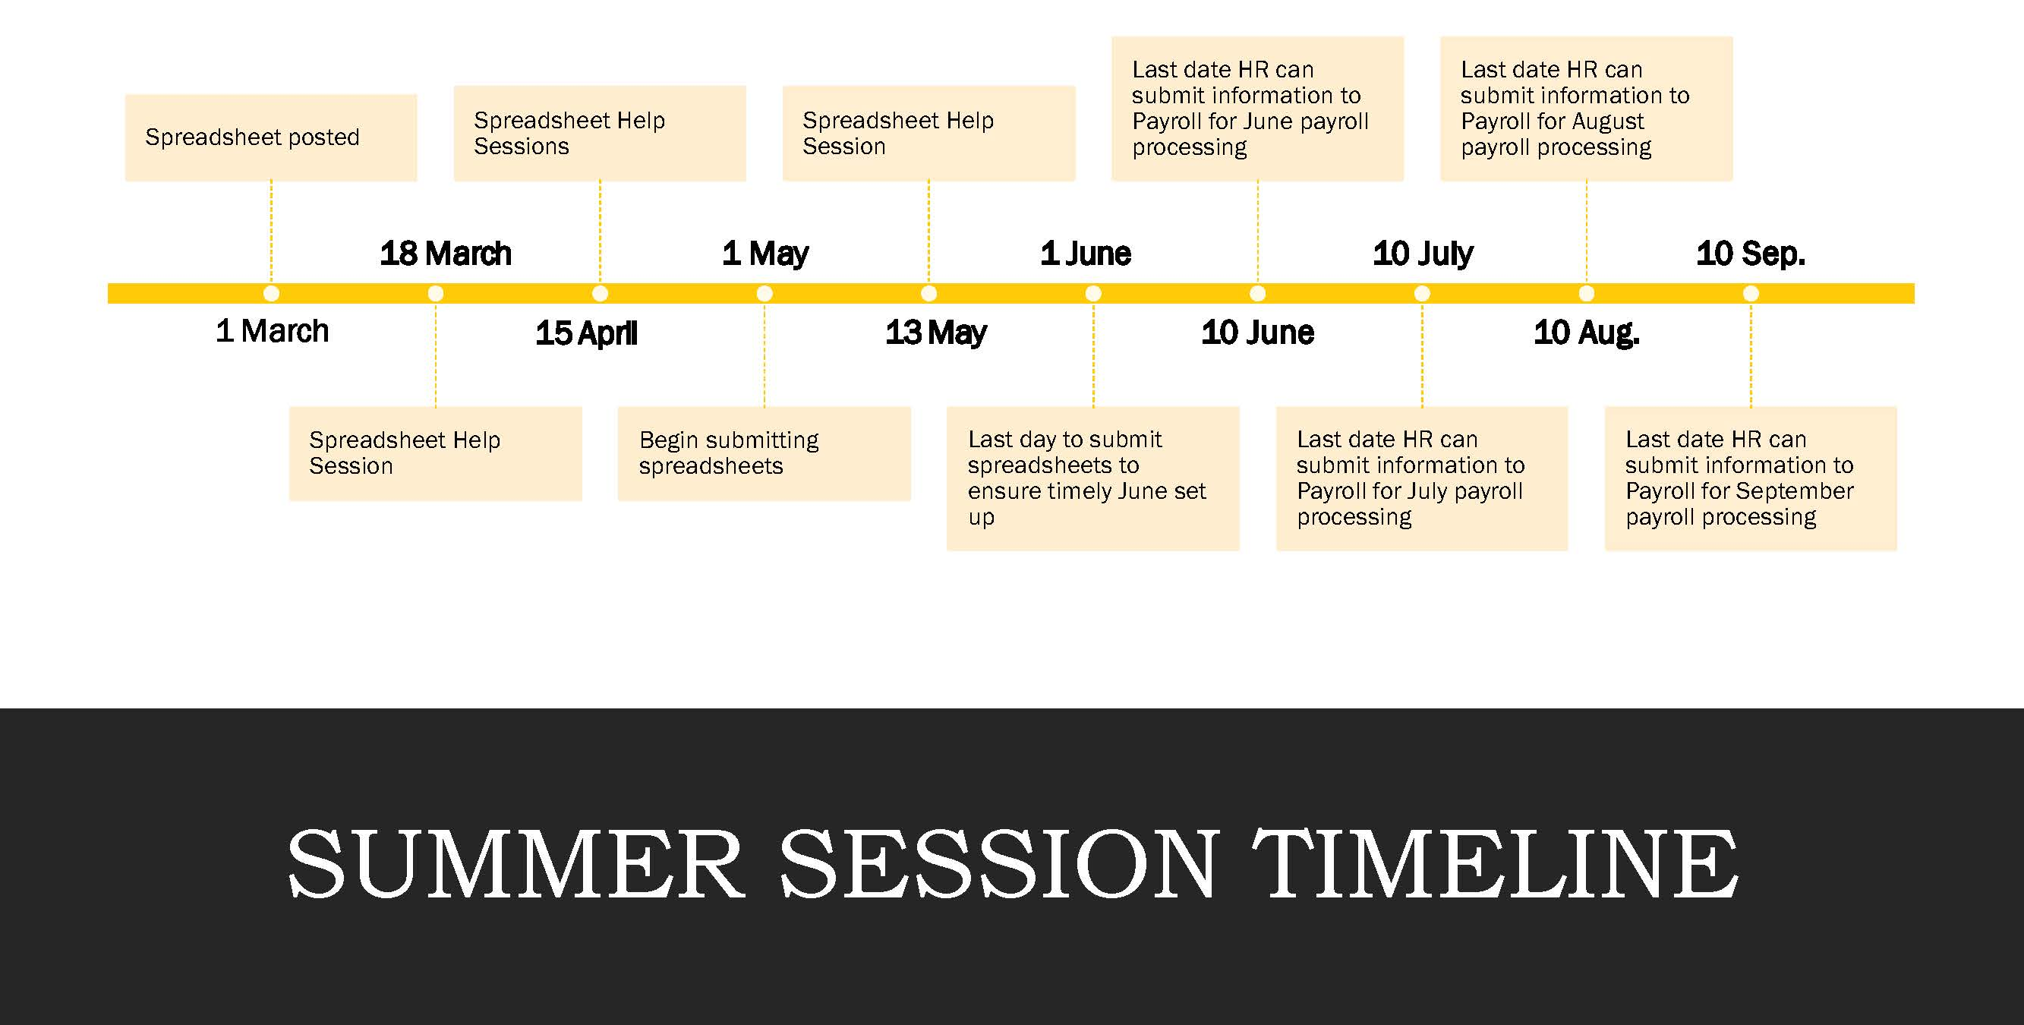
SAW Timeline

Slide 16
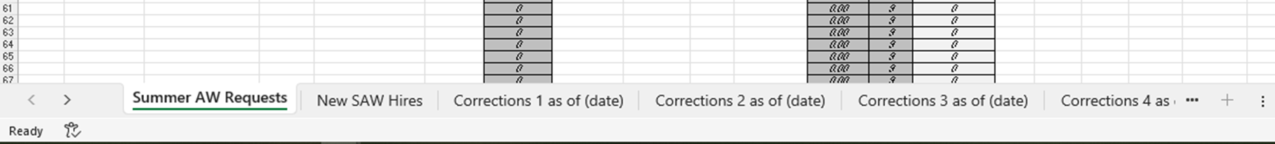
SAW Spreadsheet
The spreadsheet is long and covers columns A-Z
Please note at the bottom of the spreadsheet is where you will find the various correction tabs

Slide 17
SAW Corrections/Additions
Utilize HRSD to send an updated spreadsheet
REMINDER: When you submit a correction to a previously submitted request you need to submit it as what the new total FTE or lump sum amount is
  EG: Employee A is paid $500 to teach one class during Session 1
  Registration requires the opening of another session, and Employee A is now being asked to teach a second class during Session 1
  Department submits an updated spreadsheet utilizing one of the Corrections Tab. The new request now shows that the employee will be getting paid $1000 total for their summer appointment

Slide 18
SAW Letters
Notice of Appointment Letters will be generated and distributed at time of processing
  For appointments set up prior to July letters will be sent to employees via HRSD with letters viewable via the Employee Service Portal: https://mysupport.oregonstate.edu/esp
  For appointments set up in Workday letters will be sent to the employee directly via their Workday inbox

Slide 19
SAW Next Steps
Departments can begin working on their spreadsheets now
Consider attending a help session
Contact HRSupportServices@oregonstate.edu with questions
Visit the SAW website to access helpful resources

Slide 20

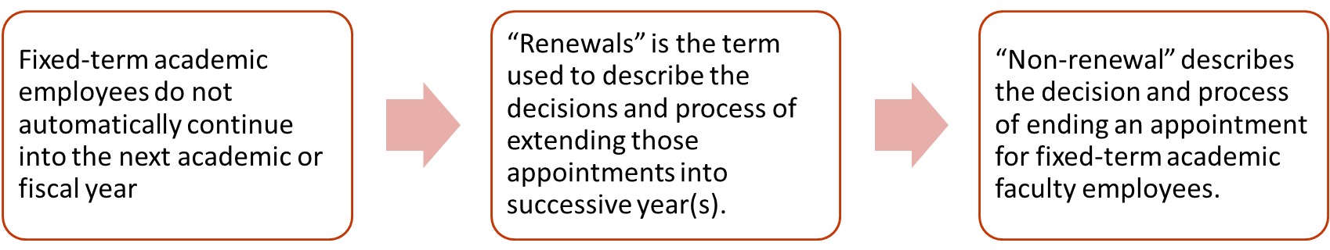
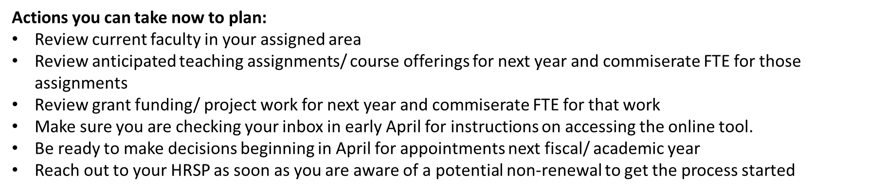
Fixed-Term Renewal Sneak Peek for April’s Forum:
What are Fixed-Term Academic Renewals?

Slide 21

Questions?

Slide 22
THANK YOU

