Slide 1
UHR/PAYROLL FORUM
April 16, 2026

Slide 2


General Information
You can raise your hand or put your questions in the chat
Forums are always recorded
You can find recordings and slides for each forum on the UHR Calendar and Communications website. Links and topics for future sessions are also listed there.
This forum’s recording and slides will be emailed along with the registration link and list of topics for the next forum

Slide 3
Agenda
Announcements
Rec Sports 3-day pass
Benefits triple process
Summer health insurance – Grads
Fixed-Term Renewals

Slide 4
Announcements
The Payroll Operations Team is now located in University Plaza Suite 150!
  Employees or students picking up physical paychecks or who have payroll-related questions should visit Payroll Operations in their new location at University Plaza, Suite 150. This will be the only location for check pick-up. Please visit Payroll Operations for more information.
Student Employment AMP Cutover
  Student hourly positions must have a start date on or before June 12, 2026.
    If students remain in the queue after June 12, their start date will be moved to July 6 and they CANNOT work until then.
  May 15, 2026, is the last day supervisors can submit supervisor updates with an effective date no later than June 1, 2026.
  June 1, 2026, is the last day supervisors can submit wage increases with an effective date no later than June 1, 2026
  Graduate Assistantships for Summer term must be entered into BennyHire by June 9, 2026 with the start date of June 16, 2026.

Slide 5
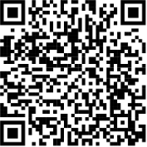
Announcement – Financial Literacy Month
The OSU Employee Benefits Retirement Team invites all OSU Employees to attend financial literacy sessions in April for Financial Literacy Month. Registration for the remaining sessions is open now!
  Fundamentals of Retirement Income Planning. Led by Fidelity. April 16, 12:00-1:00 p.m. (Right after the forum!)
  Introduction to Oregon Savings Growth Plan. Led by OSGP. April 20, 2:00-3:00 p.m.
  All about OPSRP. Led by PERS. April 28, 10:00-12:00 p.m.
Attend as many sessions as you wish. To register, scan the QR code and search for Financial Literacy.
All sessions will be held on Zoom.

Slide 6

Announcement – AMP
9:00 AM – 3:00 PM

Slide 7
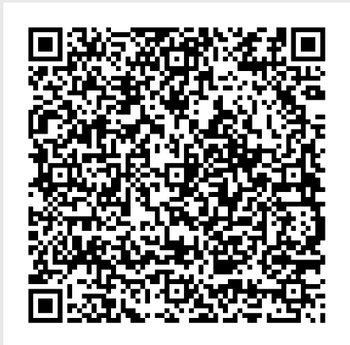
Rec Sports 3-day pass overview
Start your health and wellness journey at Rec Sports with the first three days FREE!
Our Facilities
Dixon Recreation Center
Courts, Lap & Dive Pool, Indoor Climbing Center, Fitness Studios, Weight Rooms, Indoor Track
Amenities: Locker rooms with towel service, day-use lockers, sauna, free sport and pool equipment rental
McAlexander Field House (MAC)
Courts, Indoor Climbing Center, Indoor Turf Field, Functional Training Equipment
Student Legacy Park
Soccer, Football, Softball Fields, Outdoor Track, Indoor & Outdoor Tennis Courts
Jump into a fitness journey right for you!
Group Fitness Classes
  Cycling, Pilates, Yoga, Aqua Fit, Full Body Strength
Fitness Training and Assessments
  Small Group Training
    DAM Fit (HIIT), Olympic Lifting, Kickboxing, Functional Training
    Wellness Coaching & Fitness Friends
Aquatics
  Adult Swim Lessons & Clinics
  Child Swim Lessons (For Rec Sports Members)
Adventure Leadership Institute
  Adventure Trips
  Climbing Events
  Discounted Outdoor Gear Rental
Sign up here if you are interested!
OSU Faculty and Staff Membership Options: 1-month, Term, 9-month, Annual
Spouse and Partner Membership: 1-month, Term, 9-month, Annual

Slide 8
Benefits Triple Process
Summer insurance coverage is provided to PEBB eligible employees in qualifying positions. Summer insurance is provided to academic year ACA eligible employees who are not ending employment on June 15th.
For more information about the process and key details, please see this link: PEBB Summer Insurance Process | Office of University Human Resources | Oregon State University
To pay for PEBB summer insurance coverage, benefit premiums are "triple deducted" in May. This includes OSU’s contribution toward the core premium cost (medical, dental, basic vision, basic life), as well as the employee’s share of premiums (exceptions: FSA Contributions, Short Term and Long Term Disability premiums).
The May Payroll is used for the tripling process since it is typically the last full check before summer. The June checks are usually partial checks. Sometimes triples can happen in June if the employee is missed in May
The triple process is not optional if the employee is enrolled for PEBB coverage and meets the triple requirements

Slide 9
Process Deadline
Instructors in PEBB-eligible positions during spring term who are not returning for fall term should notify HR Support Services through the Employee Service Portal (HRSD) utilizing the Offboarding request, or via e-mail at hrsupportservices@oregonstate.edu to initiate the employment termination process.
  Employment terminations for instructors on term only contracts processed by April 30th will result in employees not going through the summer triple process during May
  Employment terminations for instructors on term only contracts processed between May 1st – June 15th will have any necessary corrections to PEBB premiums processed during June payroll by the Employee Benefits team
  Employment terminations for instructors on term only contracts processed after June 15th will result in summer insurance for the instructor
  Program Details: PEBB Summer Insurance Process | Office of University Human Resources | Oregon State University
All other academic year employees in PEBB-eligible positions during Spring term will go through the May triple process for summer coverage

Slide 10
Summer Health Insurance – Grad Assistants
All Graduate Assistants with a position during at least one term of the academic year are automatically enrolled in health insurance for the following summer session (July, August and September).
Premiums are deducted over a course of 9 months between October and June, prior to summer session
No premiums are deducted in July, August, or September paychecks for Grad Assistants who prepaid*
  *Grad Assistants who start new in Summer Session will pay premiums during the summer months since they have not prepaid premiums throughout the academic year.
Opt-Out Process – Forms required by May 1st
  Can opt-out of summer insurance if they are not employed in a Graduate Assistant position during summer term.
  MUST opt-out of summer coverage if graduating prior to summer term and/or not returning as a student either summer or fall term.
    Employee Benefits is provided a graduation report in July and will terminate coverage for Graduate Assistants who graduated in the academic year.
Opting out of summer coverage is not the same process as waiving out of the plan.
For questions, please reach out to gradhealth@oregonstate.edu

Slide 11
Summer Health Insurance – Grad Employees
Graduate Fellows do not prepay for summer session but have the option to opt-in and triple pay the premium in May if they are returning as a student either summer or fall term.
Not applicable to Postdoctoral Scholars and Clinical Fellows who only pay premiums during the months they are employed.
For questions, please reach out to gradhealth@oregonstate.edu

Slide 12
Fixed-Term Academic
Faculty Renewals for FY/AY 2026-27
Notes:
General navigation
Grant funding
Enrollment
Uncertains:
Timelines
Types of uncertains:
Actual intended non-renewals
Retirements/ Resignations
Variable FTE/ appointment dates?
Contract Changes: FTE, # terms, duration of contract
Promoted
Mutual Agreement
Non-promoted
Please communicate with HRSP
Non-renewals
Partner with HRSP immediately
Business Case/ Review of request
Approvals
Notification process and deadlines
What happens if I’ve missed the notice window for non-renewing this fiscal year?

Slide 13
Quick Refresh:
What are Fixed-Term Academic Renewals?
Fixed-term academic employees do not automatically continue into the next academic or fiscal year
“Non-renewal” describes the decision and process of ending an appointment for fixed-term academic faculty employees.
“Renewals” is the term used to describe the decisions and process of extending those appointments into successive year(s).

Slide 14
2026-27 Fixed-Term Academic Faculty Renewal Timeline
April 14- April 28
Beginning May 8
Sessions with designated HRSP
Fixed-term academic renewal letter distribution
Last day to record renewal decisions using online tool
April 6
Fixed-term renewal memo sent by UHR
April 8
Fixed-term renewal online tool registration memo sent by Kadie Powell to all users
April 28
April 13
Fixed-term academic renewal tool link issued by HR Strategic Partners, with instructions
The timeline is driven by commitments made by OSU and UAOSU via the collective bargaining process.

Slide 15
New for AY26-27
Faculty who have achieved promotion or were hired into a promoted rank are not included and are transitioning to continuous employment.
Reminders
No more Excel spreadsheets for renewals
All decisions recorded in online tool
Must register to use online tool before will have access
Employees with pending promotions are included, but will transition to continuous employment if awarded promotion.
The renewal process is not a performance management process.

Slide 16
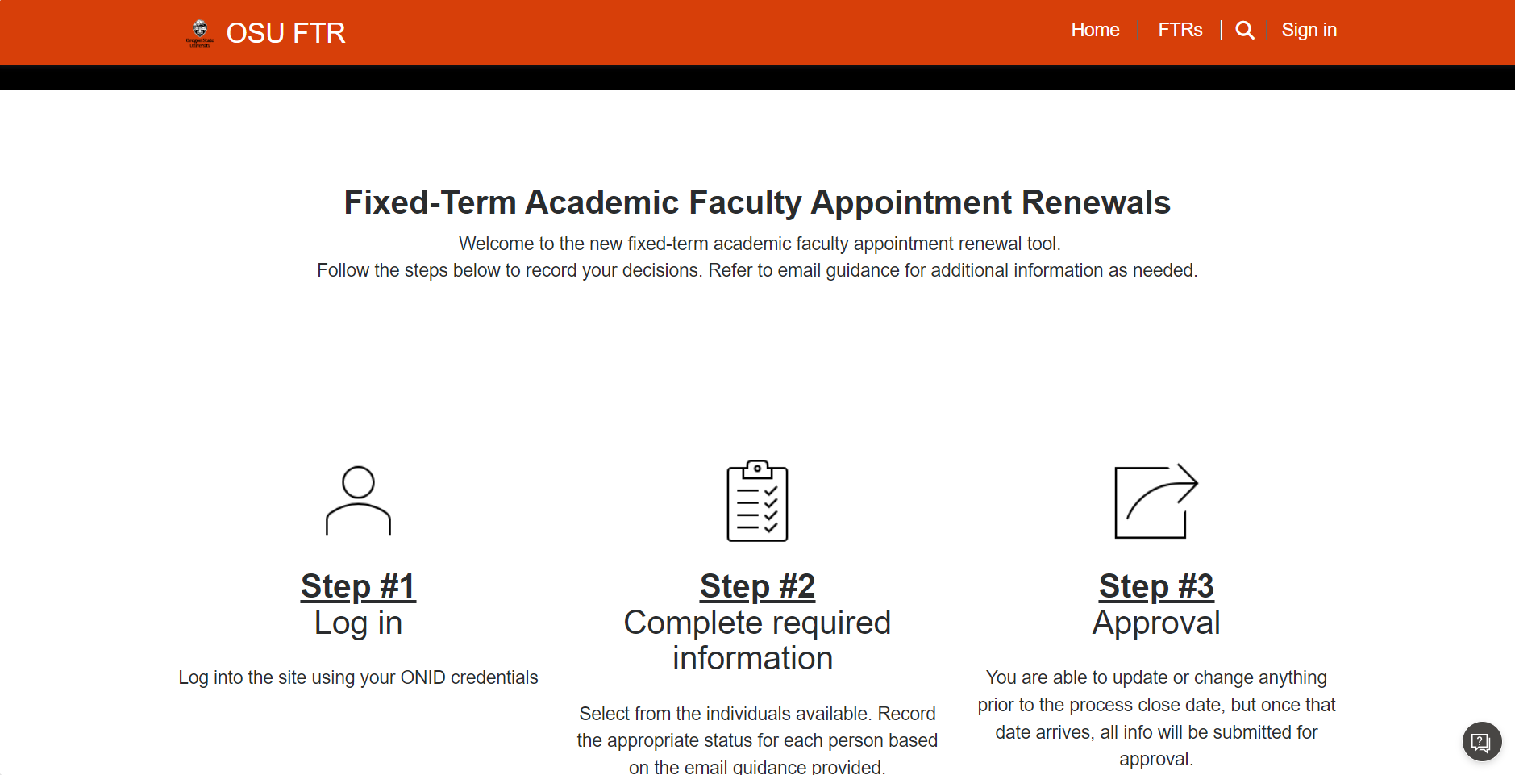
Register to Use the Application
ALWAYS use a fresh Microsoft Edge browser window. Turn off extensions such as pop-up blockers.
Make sure you have registered, using instructions sent on April 8. You cannot use the online tool without registering first.
Navigate to the platform at
https://ftrprocess.powerappsportals.com
Sign in to the platform.

Slide 17
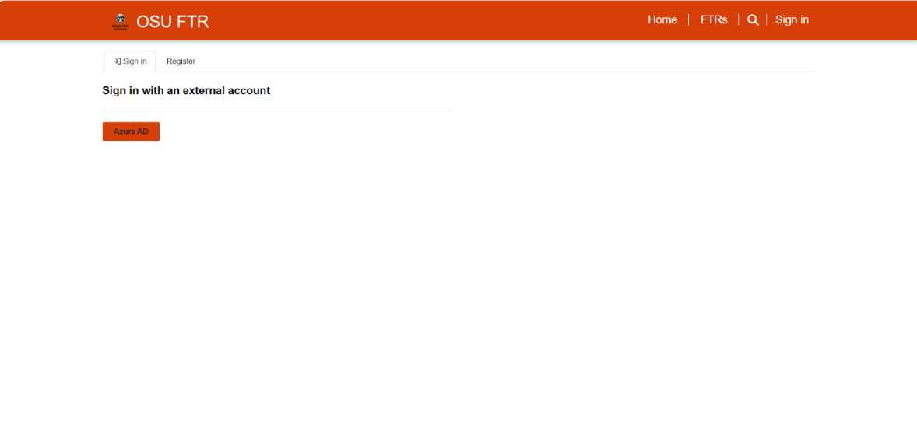
Log-In
Click on Azure AD to complete your sign in.

Slide 18
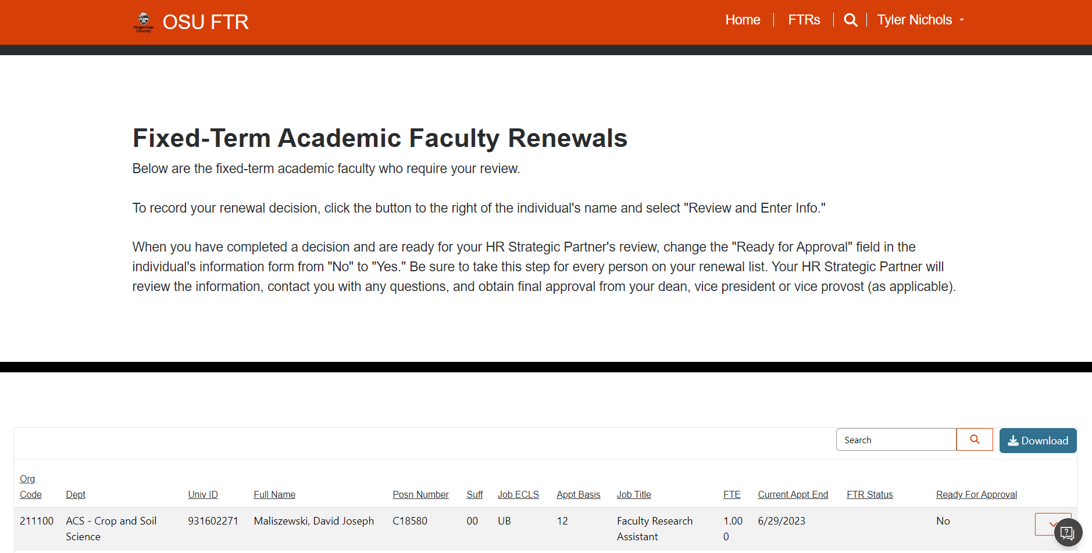
Steps to Record Renewal Decisions
You are now signed in and will see your name in the upper right hand corner. You have access to fixed-term academic faculty in specific timesheet organizations. Again, be sure to use Microsoft Edge for all FTR tool activities.

Slide 19
Steps to Record Renewal Decisions
Double click on any employee’s name to view their FTR record. Each person’s record must be updated separately.
This field will only populate if an end date is in Banner

Slide 20
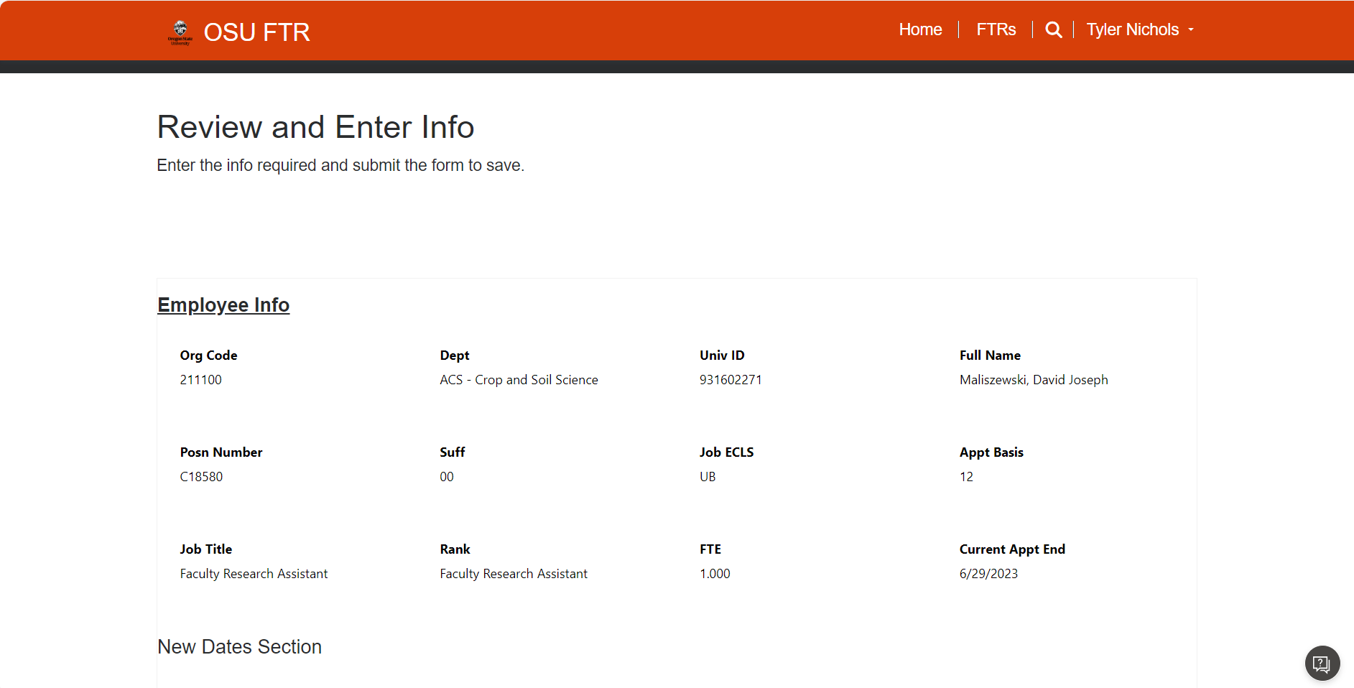
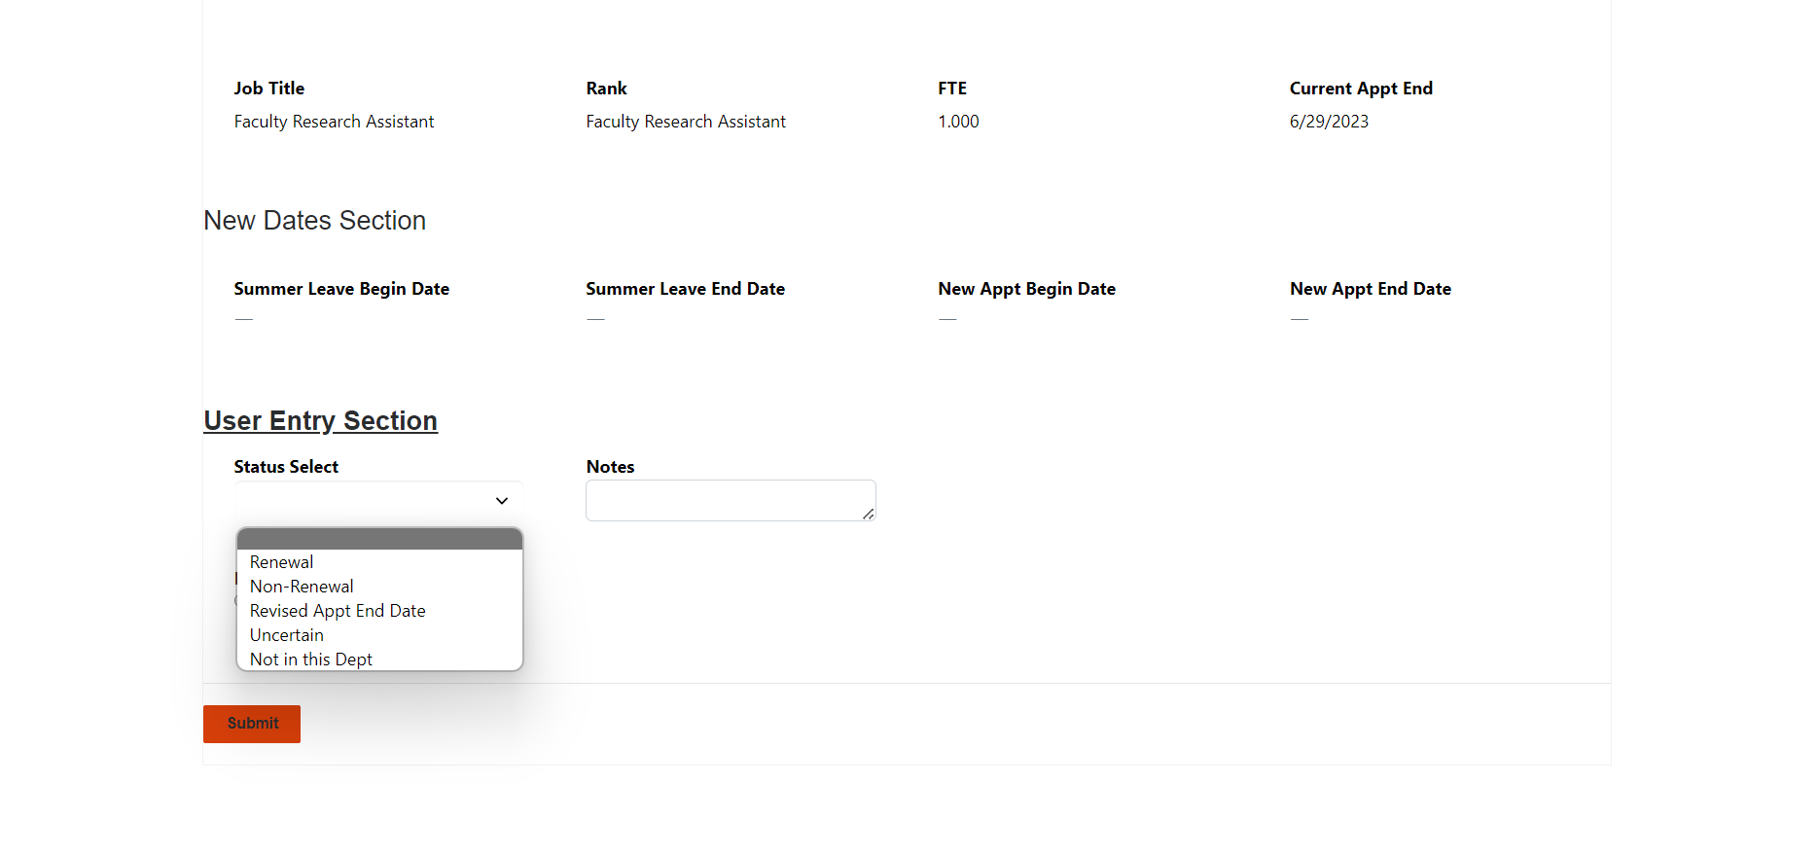
Steps to Record Renewal Decisions
Select the correct status using the status select drop-down menu and the instructions sent on April 8.
Decisions must be recorded one by one.
New dates info will populate once a decision has been made.
Decisions are made using the Status Select dropdown.

Slide 21
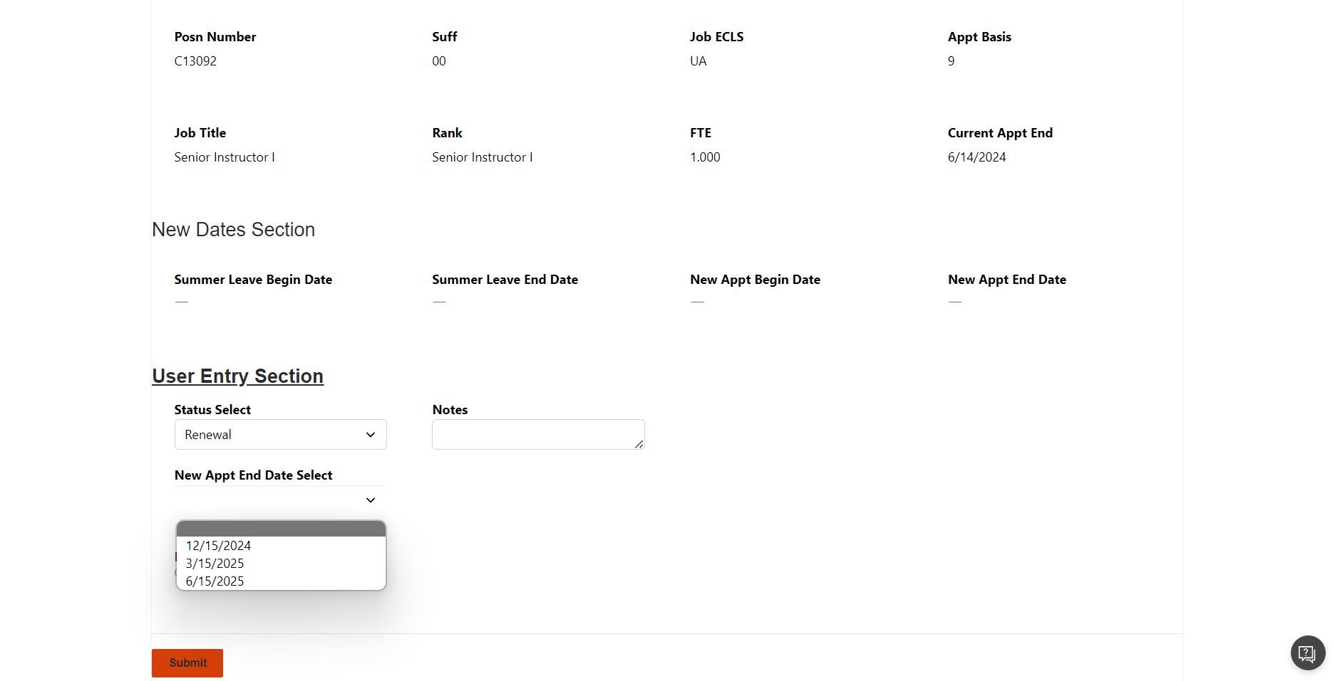
Steps to Record Renewal Decisions
Entering “renewal” on a 9-month appointment will populate a date dropdown field for your entry
You must select a renewal date.

Slide 22
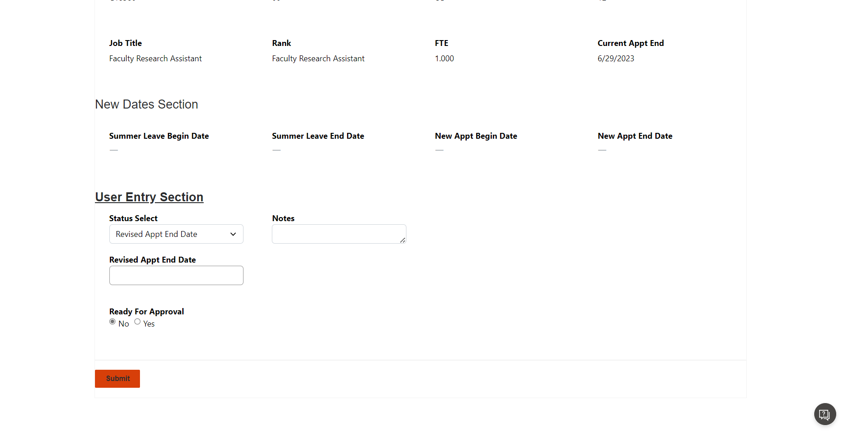
Steps to Record Renewal Decisions
Use the Notes field to record any additional details, again using instructions given on April 8
If you select Revised Appt End Date, a new box will appear that asks for the end date. You must enter a revised end date.

Slide 23
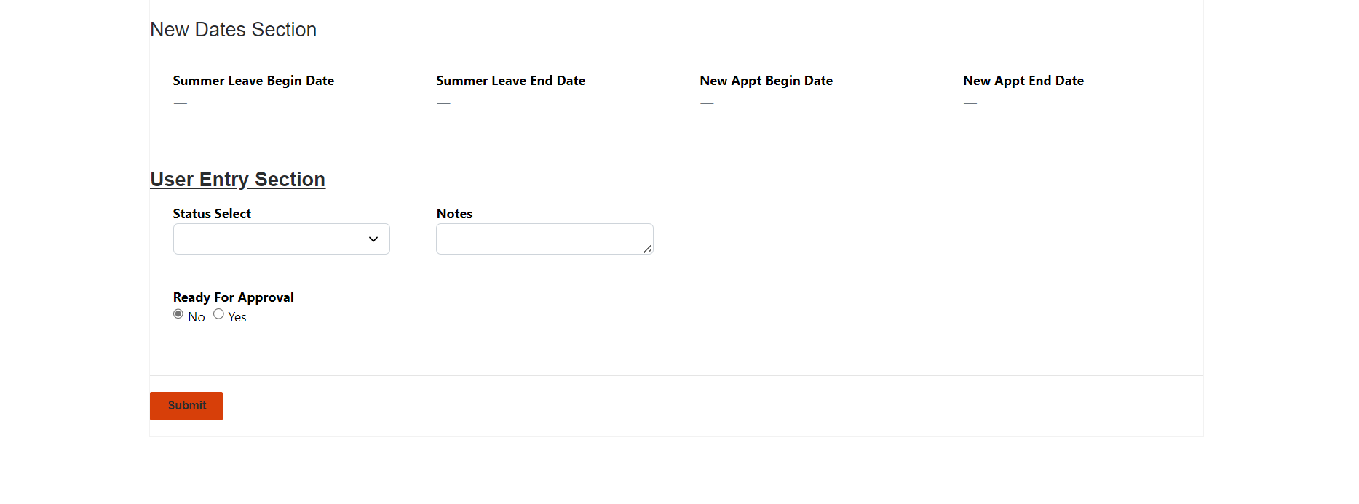
Steps to Record Renewal Decisions
If you would like more time to think about the decision, leave the “Ready for Approval” button at “No” and click “Submit.”
When you are ready for your HRSP to assess, click “Yes” in “Ready for Approval” and hit “Submit.”
The HRSPs will gather approval from deans, vice provosts and/or vice presidents, as appropriate
When you have made a decision you will select Yes and click Submit

Slide 24
Help with the Online Tool
You must use the Microsoft Edge browser. Turn off all extensions that overwrite scripts, such as popup blockers. The FTR tool uses scripts, so other extensions may cause the FTR tool to fail.
You have access to specific organization/timesheet codes, not to every employee. If you need to see someone outside your organization, the HRSPs can help.
Your HR Strategic Partner can access the records at any time, help navigate decisions, or escalate any system issues.
Double-check that you’re registered if you can’t get into the system
If you’re newly registered, it may take a day to provide access
More resources have been provided to users to aid decision-making

Slide 25
Renewal Decision Guidance

Slide 26
Renewal Status Options
Renewal
Assigned work at the beginning of the new renewal period (i.e., a 9-month faculty member is assigned teaching for fall term)
Use if a non-renewal proposal has been approved, the employee has been informed in writing by the supervisor and HR, and you are prepared for the appointment to be automatically ended in Banner. This is RARE.
Revised Appointment Date
Same FTE
New appointment will begin the day after the current appointment ends
Must specify when the new appointment will end
Same FTE as displayed in the system
Non-renewal
Uncertain
Removes employee from automated processes
Use when FTE is changing
Not in this department
Recall the spreadsheets based on data snapshot from mid-March; changes since that time not reflected
Indicate which timesheet organization the employee should be moved to. If you are unsure, contact your HRSP.
Removes employee from automated processes
Use if you have received a written resignation from the employee
HRSP and/or ELR will work with department on decisions and will inform Service Center if Banner processing or renewal letter is needed
Most commonly used in situations where external funding is uncertain on 12-month appointments.
Use if considering non-renewal but approval has not yet been obtained
Use if situation is otherwise too complicated for automatic processing

Slide 27
What Happens After “Uncertain”
Person was marked “uncertain” in the renewal tool
HRSP continues follow-up with the department
Decision
Person added to tracking tool
Renewal
Non-renewal
HRSP informs the Service Center
SC updates Banner and generates Notice of Appointment
Employee receives NOA via DocuSign email process
If approved, E&LR/HRSP write non-renewal letter
If approved, supervisor and HR meet with employee
HR notifies Service Center
Service Center processes
HRSP assists supervisor with request

Slide 28
Advance Notice of Non-Renewal At a Glance
Factors that impact notice
Resulting notice
Appointment Duration in AY`25
Renewal Notice
Non-Renewal Notice
Employed 1-2 terms in AY`25-26
No contractual timeline to receive renewal notice, but should still receive as soon as feasible
No advance notice of non-renewal required if not reappointed
Employed 3 terms in AY`25-26
1 month of renewal notice required prior to expiration of existing appointment.
1 month of non-renewal notice required prior to the expiration of existing appointment

Slide 29
Notices of Appointment (NOA)
All Notices of Appointment for instructional positions will include enrollment language
NOAs are issued to employees via DocuSign process and are not provided to departments.
NOAs do not include language about grant or other “soft” funding.
INTO has unique language for its instructors

Slide 30
Common Concerns and Needs
Trying to change FTE via the renewal process
We cannot change FTE via the automated portion of the renewal process due to Banner limitations.
Someone you expected to see does not appear on your list in the tool
Only fixed-term academic faculty who have active appointments on the day of data snapshot are reflected in the online renewal tool. If you need to renew an inactive employee, please speak with your HRSP.
Changes to renewal decisions after the deadline
Once your decision is approved, the employee’s Banner record will be updated and a Notice of Appointment will be issued.
The more changes made after the deadline, the more likely it is that human error will occur. We all want this process to be accurate and timely, for your department and to show respect for the employee.
If you need to change FTE, mark as “uncertain” and create a note following HRSP guidance in the notes section, and be aware that the request will be processed manually.
Your department needs to know what was recorded
All users have the ability to download their data. We suggest downloading in CSV format, which is easily manipulated in Excel.
Please download on or before April 28th, 2026.
If you make a decision after the deadline, inform your HRSP.
The person you are thinking of may not hold a fixed-term academic faculty appointment. Talk with your HRSP.
Your HRSP or your department can run a list of inactive employees to ensure no one is missed.

Slide 31
Questions?

Slide 32
Final Questions?

Slide 33
THANK YOU

