Slide 1
UHR/PAYROLL FORUM
May 8, 2026

Slide 2


General Information
You can raise your hand or put your questions in the chat
Forums are always recorded
You can find recordings and slides for each forum on the UHR Calendar and Communications website. Links and topics for future sessions are also listed there.
This forum’s recording and slides will be emailed along with the registration link and list of topics for the next forum

Slide 3
Agenda
Announcements
Work Life updates
Form I-9 compliance
Update on New Employee Welcome (NEW) 101/102
Human Resources Support Services (HRSS) Cutover dates
Administrative Modernization Program (AMP) update

Slide 4
Announcements
Reminder: The Payroll Operations Team is now located in University Plaza Suite 150!
  Employees or students picking up physical paychecks or who have payroll-related questions should visit Payroll Operations in their new location at University Plaza, Suite 150. This will be the only location for check pick-up. Please visit Payroll Operations for more information.

Slide 5
Work Life updates
Lyra
  Employees can now opt to continue to see their Lyra provider after their 8 sessions OSU provides at their own cost. This will take effect this month.
Exemplary Employee Awards
  The nomination period for the Exemplary Employee Awards is now open! We will be accepting nominations through May 31.
  Do you know a classified staff or professional faculty member who goes above and beyond? If so, University Human Resources is now accepting nominations for the 2026 Exemplary Employee Award!
  If you would like to recognize someone in your unit or elsewhere on campus who exemplifies great service to OSU, you can find out more information about the award and nomination process online.
    Please send hard copy nominations to
      University Human Resources
      Attn: Christina Schaaf
      236 Kerr
    Please send digital nominations to christina.schaaf@oregonstate.edu

Slide 6
I-9 Compliance
What is the I-9 and why do I need to care about it?
  The I-9 is a federally required form that must be completed and on-file for all paid employees
  The I-9 is what employers use to verify that the people they hire are authorized and eligible to work in the United States
  Any person hired into a paid position in the United States on/after November 6, 1986 is required to complete an I-9
    People hired before that date are not required to complete an I-9
  The completion of the I-9 is built into the process to hire all paid employees at OSU and is managed via Student Employment and HR Support Services

Slide 7
I-9 Compliance, cont.
When does the I-9 need to be completed?
  Per USCIS guidelines, Section 1 of the I-9 must be completed by the employee on or before their first date of employment
    The I-9 cannot be initiated until an offer of employment has been made
    The employee has three days from their start date to complete the in-person verification of documents
    If the hire will only be working for three days or less then the I-9 must be fully completed on or before their first day
  For Student Employment, the I-9 must be completed on or before the employee's first day
  For HR Support Services, the I-9 must be completed within three days of employee's start date

Slide 8
I-9 Compliance, cont.
Failure to complete the I-9 within the required timeline can lead to disciplinary actions up to and including termination of employment
Failure to complete the I-9 can also lead to monetary fines that are charged to the hiring unit – can quickly escalate to the thousands
  First Offense: $716 to $5,724 per violation
  Second Offense: $5,274 to $14,308 per violation
  Third+ Offense: $8,586 to $28,619

Slide 9
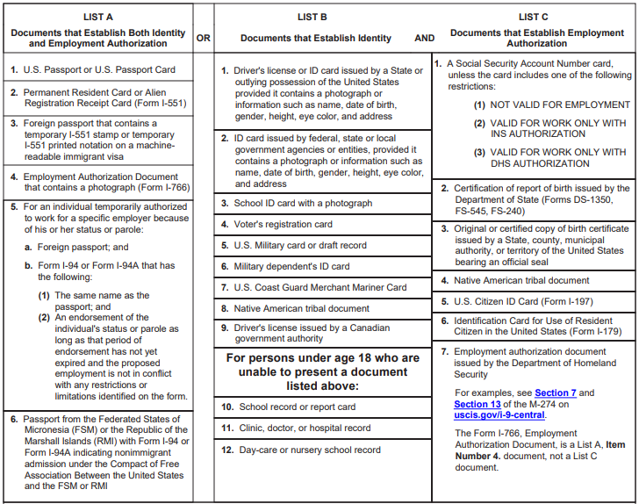
How to Complete the I-9
To complete the I-9, the employee must go through an in-person verification of original, unexpired documents that show they are eligible to work in the United States
  USICS has a publicly available list of acceptable documents to present that is included with the I-9
  Employer cannot tell an employee which documents they need to provide

Slide 10
In-Person vs. Remote Agent Requirements
In-person verification is managed by Student Employment and HRSS
If an employee is remote, a Remote Agent can verify and complete the Section 2 of the Form I-9 on behalf of OSU
Remote agents sound much more formal than they truly are. To be a remote agent, an individual must:
  Be over the age of 18 and able to meet with the employee in-person
  Have internet access
  Have photo imaging capabilities (e.g., scanner, smart phone)
Neighbors, colleagues, roommates, and supervisors are all examples of acceptable remote agents
What if the Remote Agent makes a mistake?
  Student Employment and HRSS can manually correct to ensure it is accurate and on-file

Slide 11
I-9 Reverification
I-9 Reverification is needed whn a terminated employee is being re-hired back or when a Non-Resident Alien's work authorization documentation has expired
  For current employees, the Student Employment or HRSS Team will begin notifying individuals when their documentation is 90 days out from expiration and inform them they they need to reverify their employment eligibility documents
  For re-hired employees, reverification should happen prior to or on their first date of re-employment
If a Non-Resident Alien is sponsored by OSU and needs their work authorization extended, managers and the employee need to reach out to Office of International Services (OIS) as soon as possible
  Delays in paperwork processing could lead to gaps in employment or Leave Without Pay (LWOP)

Slide 12
We Need Your Help!
I-9 compliance is UHR's responsibility, but we need everyone's assistance to ensure we stay compliant with federal regulation
How can you help us out:
  When you onboard a new employee in your department, please be sure the complete the I-9 process
  When we must reverify an employee's work authorization, please pay attention to the emails we send out to ensure this is taken care of timely
  When an employee leaves their position, please notify us immediately
Question about I-9s can be directed to:
  Student.Employment@oregonstate.edu for all Student Hourly and Grad Assist positions
  HRSupportServices@oregonstate.edu for all non-student positions

Slide 13
Update on The New Employee Welcome (NEW) Program
NEW 101: Onboarding
NEW 102: Orientation
Getting started at OSU
Employment Overview & Basics
Techucation (system tutorials)
Work, Life, & Belonging Resources
Benefits
Welcome to OSU!
Ombuds Services
Equal Opportunity & Access Supports & Resources
Insurance & Risk Management
Work, Life, & Wellness Resources
Retirement Options
Learning Opportunities
Union Informational Sessions

Slide 14
Update on The New Program, cont.
NEW 101: Onboarding
NEW 102: Orientation
It is highly recommend that all employees attend within their first week
Offered 2x/week on the Corvallis campus and 1x/week virtually
Employees are automatically registered and registration is tied to their start date
It is highly recommended that employees attend within their first month
Offered monthly via Zoom
  An in-person Orientation is offered every September (Corvallis Campus)
Register online!

Slide 15
Update on NEW Program: Future State
With the hiring pause (save for academics) throughout the month of June, NEW 101 will be offered on an as-needed basis for new and transitioning employees
During June, HRSS and Learning & Development will be working together to innovate the NEW Program to reflect Workday processes
  Techucation will still include:
    Updating employee profiles (address, email, Direct Deposit)
    Accessing Critical Trainings
    Reviewing the HR/IT Ticketing system
    Learning how to interact with the timekeeping system including time entry, time-off, leave accruals, and protected leaves
    Other need-to-know items for new hires navigating the system
  NEW 101 will launch its revamped program in mid-July

Slide 16
HRSS Cutover dates
May 15 – last date to submit supervisor updates or FTE changes with a June 1 effective date
Academic Appts will continue to be processed in Banner until we go live in Workday
  Continue to submit your Summer Academic Wage spreadsheets
  Continue to work with your HRSPs and HRSS team regarding any Fixed-Term Renewal that is uncertain

Slide 17
Save the Date!
AMP Manager + HR Liaison Showcase
Wednesday, May 27th
9:00am-4:00pm
Alumni Center Ballroom
Learn more and Register Here

Slide 18

AMP MONTHLY UPDATES:
MAY
Everything you need to know to stay up to date about AMP
May 2026

Slide 19
AMP May Updates
60 Days to Go-Live
Advanced Training Kick Off
What to Expect on Day 1:
On July 6th, OSU will start using Workday and you’ll have access to the core functions needed for critical operations:
Not everything will be available right away. Additional processes, reports, and features will be introduced in the coming months. Visit AMP’s Essential Go-Live Outcomes page to learn more.
What You Can Do This Month to Prepare:
Bookmark the Change Hub for easy access to your persona, key changes, and tailored training resources
Know your support network – Ask ChAMP who serves as the Change Champion or Workday Foundational Liaison for your unit or college
Revisit AMP readiness resources on the AMP SharePoint
Resources to Help You Prepare for July 6th
There are many resources available to on the AMP SharePoint to help you build familiarity with new ways of working and feel prepared for Day 1 changes:
AMP Readiness Series Recordings – Revisit important concepts, updates, and reminders
ChAMP – Find the answers you need about AMP and look up important glossary terms
FAQs – Review common questions and answers by topic for quick guidance
Training – Review on-demand resources to build the skills needed for your role in Workday and consult the high-level training timeline
Video Library – Explore recordings from AMP events and trainings, including Workday demos and introductions to new workflows
Advanced Training Begins this Month
Advanced training is offered for employees who will complete most of their daily work in Workday and need to be ready to use new systems and processes on Day 1 to reduce operational disruption.
What to Know about Advanced Training:
Training invitations were based on each employee’s assigned Workday role. AMP is aiming to send out invitations four weeks prior to delivery.
Roles were reviewed by the AMP team and unit/college leaders to match training to responsibilities.
If someone was not invited but believes they should be, they should contact Robbyn Brown, AMP Training Coordinator.
Recordings of all Advanced Training sessions will be posted to the AMP SharePoint for easy access.
If Advanced Training does not Apply to You:
Continue to explore on-demand training resources and recorded demos via the AMP SharePoint
Payroll accuracy Time management Core HR functions Employee self-service Data and reporting platform | Security and compliance Procure-to-pay activities Budget and fund management Post-award management
Why it matters to me:
Getting Ready for Go-Live: With 60 days to go-live, taking a few steps now will help you understand what to expect on Day 1. No one will be an expert on new ways of working right away—and that’s okay! It will take time to rebuild comfort and confidence, but using these resources early can help reduce discomfort during the transition and leave you feeling more prepared at launch.
Why it matters to me:
Know Your Training Path: While you might not be invited to Advanced training you will still get access to them and there will be several on-demand resources to support you. Learn more here.

Slide 20
May: Key Dates at A Glance and Resources
AMP Key Dates at a Glance
Resources –Bookmark These!
May – June: Learning materials get uploaded to the AMP SharePoint Change Hub and advanced trainings are held for select employees.
May – June: Ongoing AMP Readiness Series. Find all of the upcoming events on the AMP SharePoint’s Events page.
May 1: If you missed the AMP Get Ready for Go-Live Fair, session recordings will be posted to and available on the AMP Video Library.
Open Until May 8: Participate in our last Change Readiness Assessment before Go-Live. Help us break our response record of 1,100 OSU community members!
May 27: Join us at the Manager and HR Liaison Showcase to learn about role-specific responsibilities and changes, key cutover dates, and day-one readiness steps to prepare for Go-Live
July 6: Workday goes live and all employees get access to the system!
Change Hub (on AMP SharePoint): One-stop shop for training & change info
Personas and Learning Journeys – Find what’s changing for your role; start with “All Employees” and discover your role-based training path
ChAMP – Find the answers you need about AMP and look up important glossary terms
FAQs – Review common questions and answers by topic for quick guidance
Training – Review on-demand resources to build the skills needed for your role in Workday and consult the high-level training timeline
Video Library – Explore recordings of AMP engagements and trainings (e.g., AMP Go-Live Fair, Workday demos, Navigator, procurement)
Notes:
Talking Points
New Tool – AMP Change Hub: The AMP Change Hub is your one-stop shop for details on how AMP will impact community groups across OSU—and where you’ll access training resources. The hub is organized by Personas, which describe day-to-day responsibilities and changes by OSU employee type. The site will be continuously updated as we approach Go-Live in July.
AMP Training – Foundational Liaisons: The AMP training team has launched the Foundational Liaisons network—employees who will help support your training journey. Within each unit, liaisons will answer foundational Workday questions and provide 1:1 support to colleagues in their work area. To find out who your Foundational Liaison is, contact your unit or college Change Champion.
AMP’s Impact on OSU’s Current Technology: As OSU transitions to a single enterprise resource system for HR, Finance, and Grants, the tools we use day to day will change. For details on the systems you use today, please review the new Future System Landscape resource, which outlines each OSU system impacted by AMP and what will happen to it.
User Experience Review (UER) Starts in February: A diverse group of OSU community members will get hands-on experience with the new system during a four-week review beginning in mid-February. Their feedback will help ensure our processes, training materials, and system performance are ready ahead of Go-Live. While the UER nomination window has closed, key takeaways will be shared in the March AMPlifier.

Slide 21
May Upcoming AMP Events
Find the most up to date events on the
AMP Events SharePoint page
Date | Title
May 12th | AMP Readiness Series: 9 and 10 Month Employees
May 18th | AMP Readiness Series: Workday Reporting for Pre‑Award Research Administration
May 21st | AMP Readiness Series: Principal Investigator Essentials in Workday
May 27th | Manager and HR Liaison Showcase

Slide 22
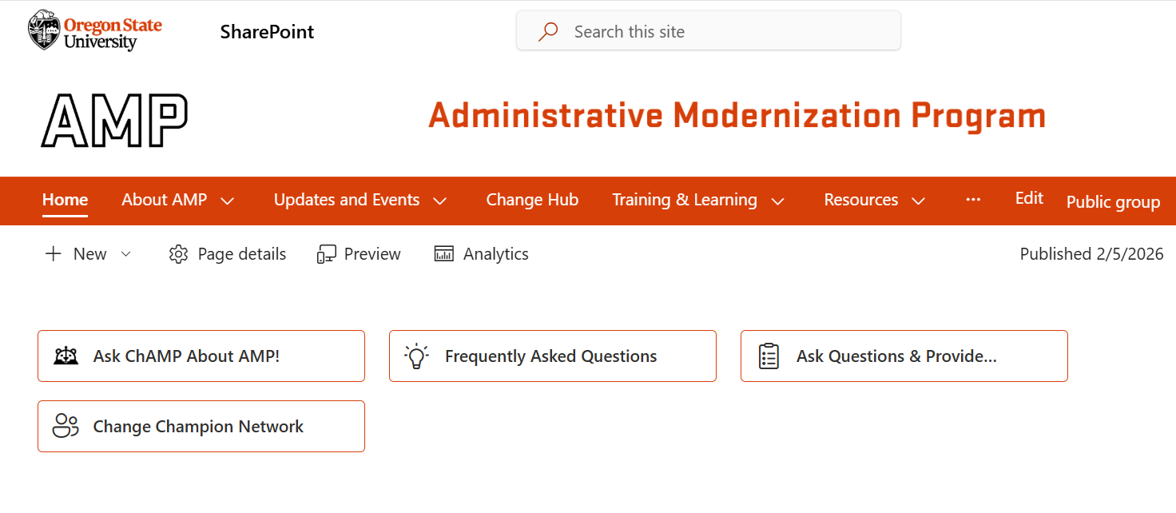
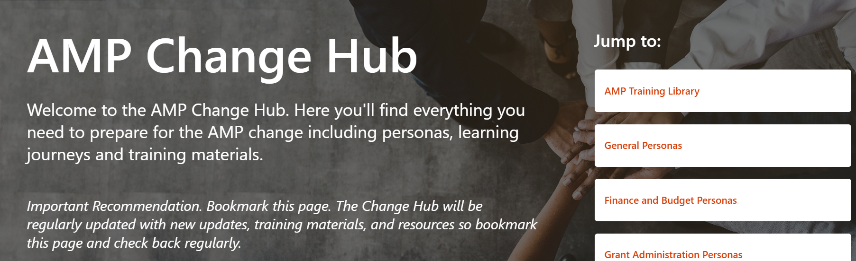
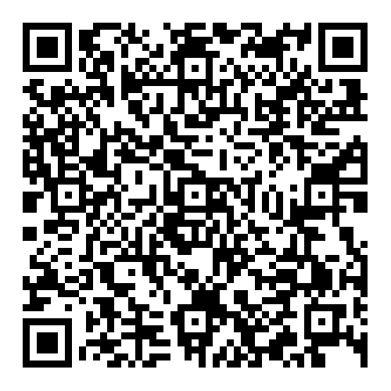
From the AMP SharePoint home page, click ‘Change Hub’ in the top bar.
AMP Change Hub
The AMP Change Hub is your central place to learn how AMP will change the way you get your work done at OSU.
It’s organized by persona so you can quickly find what’s most relevant to your role, including key impacts, resources, and training. Content will be updated regularly through the July go-live.
Learn more at: beav.es/AMP-change-hub
or Scan the QR Code
Featured Content:
Personas
Learning Journeys
Training Library and Materials

Slide 23

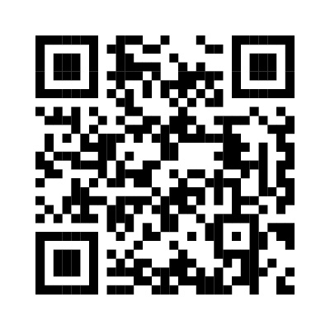
Ask me about how the upcoming changes will impact your role!
Ask ChAMP about AMP!
Not sure how AMP applies to you?
Terms or acronyms confusing?
ChAMP is a chatbot that lives on the AMP SharePoint site, designed to quickly connect you with the most timely and relevant information to support your journey through the Administrative Modernization Program transformation.
Example questions:
My role is _____. How will AMP impact me?
How can I stay updated about AMP?
Who is my Change Champion?
Learn more at: beav.es/ChAMP

Slide 24
Ask ChAMP: beav.es/ChAMP
AMP Quick Links
AMP SharePoint: beav.es/AMP-sharepoint
Ask ChAMP your AMP questions beav.es/about-ChAMP
Check out the AMP Change Hub
Find your Change Champion: beav.es/AMP-change-champions
Ask questions and submit feedback via the Always on Survey: beav.es/AMP-always-on-survey
AMP Video Library: beav.es/AMP-video-library
AMPlifier (AMP’s Newsletter): beav.es/AMPlifier

Slide 25
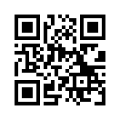
CRA 5 – Deadline Extended!
The biannual Change Readiness Assessment (CRA) measures the OSU community’s awareness of AMP and readiness for future work practices. It evaluates community attitudes, beliefs, and behaviors to gauge the effectiveness of change interventions. Insights from this data inform the delivery of future AMP community engagements, communications, and training.
Survey Link: beav.es/AMPSpring26
The deadline for CRA has been extended to Wednesday, May 13th!
Please continue to share the survey with your colleagues and encourage them to complete! Your support makes a real difference in driving CRA participation, and we truly appreciate your help in encouraging broad and candid input from across the OSU community.

Slide 26
Final Questions?

Slide 27
THANK YOU

